Slide 1
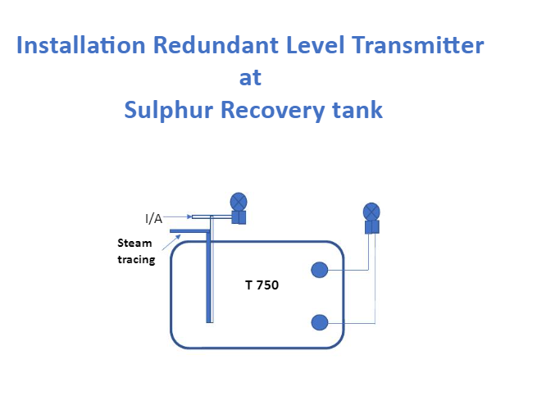

Slide 2
Bubble Level Transmitter
Principle Operation
A bubble tube immersed at a fix depth into the vessel.
The instrument air introduce into bubble pipe, as the pressure builds, bubbles are released from the end of bubble tube.
The back pressure of the introduced air is a function of the liquid level or head in the vessel, changes in the liquid level cause the air pressure in the bubble tube to vary.
The pressure transmitter takes the back pressure and converts it to an analog signal that is sent to the control room. The board operator will then be able to monitor the exact level in the vessel.

Slide 3
Regulator
Bubbler LT
I/A
Rotameter
Steam
In
Steam
out
LT5003
2438 mm
T 570

Slide 4
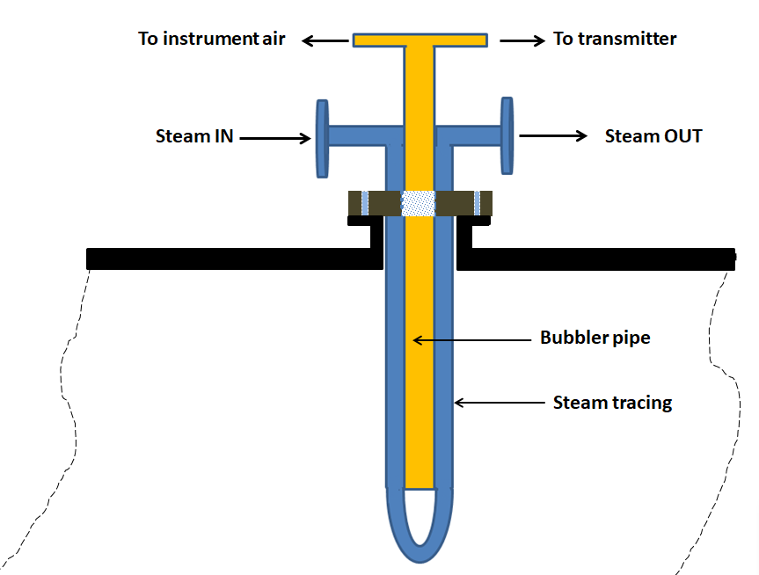
Connection flange
T- 570

Slide 5
Advantages:
High Accuracy and Stability.
Unaffected by Foam and Vapors.
Excellent for hazardous, high temperature
and corrosive media process .
Disadvantages:
The tip of the pipe can collect material from
the process, solidify, and plug the hole, hence regular checking air flow is only disadvantage of bubble level transmitter.

Slide 6
Special benefit for IBR-CS2 Plant
The presence of redundant level indication at the vessel T-570 develop trust to user about the actual level without having to carry out dipstick measurements

Slide 7


Special benefit for IBR-CS2 Plant
Spend money for safety reason always the best investment
Let's leave dipstick measurement
forever

